Slide 1
Content Understanding
A look at its document processing capabilities

Slide 2
What is Content Understanding?
Azure AI Content Understanding, built on the same foundational capabilities as Document Intelligence, extends document scenarios to images and embedded content, expanding to multimodal scenarios with audio and video.
Content Understanding is built for content processing with Generative AI, improving your ability to generate the specific output you need with inferred fields, enrichments, validations, and reasoning.
Inferred fields & enrichments: Output required that aren't always directly present in the document, like the total tax on an invoice or the jurisdiction on a contract that can be inferred from the parties’ addresses or clause wording.
Multi-file input: Process multiple input files in the same request and extract a unified schema across all the input files.
Classification & Splitting: Parse large files into individual documents for routing and schema extraction.
Reasoning: Intelligent document processing typically is a multi-step process with extraction, validation, aggregation, and reviews. Content Understanding is built for IDP, simplifying everything into a single step process.
Post processing & validations: Use the description to define any post processing rules like converting date formats, currency codes, and consistency checks.

Slide 3
What is Content Understanding for Document Processing?
It is a way to enhance your OCR of documents by using an LLM for generating additional field values or metadata not actually in the document but is based on the fields that are in the document (or in supplemental content you provide in pro-mode).
For generated fields it is like if you sent the document pages to the LLM yourself with a prompt to generate a value based on the fields in the document
But without the need to:
Convert the document pages into images
Batch the documents to fit under image limits
Create and manage the prompt.
Managing the coordination of asynchronous API calls to multiple endpoints to accommodate your quota and response times
Merge the returned JSON results from batches into a single result

Slide 4


How a Content Understanding Classifier Works
A lower code approach to enhancing your OCR
The Classifier Schema describes the different document types using a prompt for each and defines which analyzer to use to do field extraction
This is transparent to you .
You make no calls to an LLM
LLM
All orchestration to and from LLM is handled automatically
Analyzers extracts fields from a document based on a Field Schema. This is where the OCR is performed
Generated Fields
Extracted Fields
Field
Schema 1
A Field Schema defines the fields to extract using a Description for each
If it is a generated field the Description becomes the prompt
Classifier
Schema
Classifier
Analyzer 1
What kind of document is this?
Field
Schema 2
The fields in the field schema may be schemas for different entity types or may all be the same where multiple document types each have some of the needed fields to extract to complete the entire schema for a single entity
Analyzer 2
Routes to an analyzer based on classified doc type
Field
Schema 3
Content Understanding can also logically unbundle a single file that contains several different documents into their individual documents automatically
Analyzer 3
{
{
Structured Output
Many document types that look different may share the same analyzer because they are completing the same schema

Slide 5
Why Content Understanding for Document Processing?
Schema based extraction using Templates
Multiple document types can share the same analyzer
No dependency on field locations on a form
Less fragile than parsing extracted text for fields
Uses Document Intelligence like models to do the extraction
Specify “generate” or “extract” as the method in the field schema
“generate” will use an LLM to generate a field value
It doesn’t use the LLM to do the OCR
Can extract top-level entity data and child entity data such as
an order and order items
or a bill and line-item charges
Returns a structured output

Slide 6
When to choose Content Understanding over build your own model
Advantage | Azure AI Content Understanding | Build your own model
Unified, multimodal pipeline | ✅ Supports docs, images, audio, video | ❌ Requires orchestration
Enterprise reasoning workflows | ✅ In-built reasoning capabilities | ❌ Custom chaining
Prebuilt enrichments and schema normalization | ✅ Prebuilt templates available | ❌ Requires implementation
Simplified pricing | ✅ Token based pricing | ✅ Token based pricing
Enterprise governance & security | ✅ Azure security compliance | ❌ Custom implementation
Confidence and Grounding | ✅ In-built scores | ❌ Custom implementation
Chunking & normalization | ✅ Built-in algorithms | ❌ Custom implementation
Prompt tuning | ✅ Optimized automatically | ❌ Needs engineering
Context window | ✅ Optimized for long files | ❌ Manual handling

Slide 7
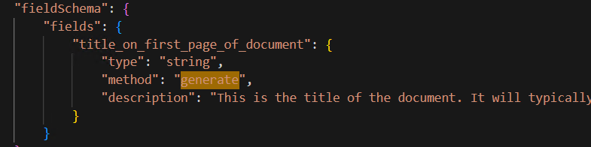
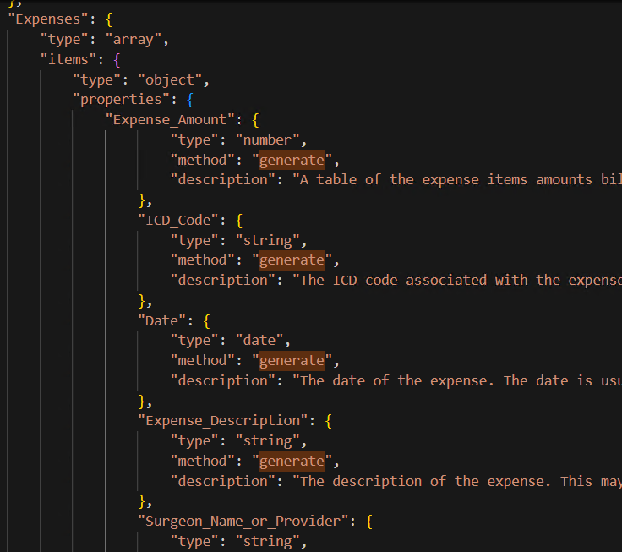
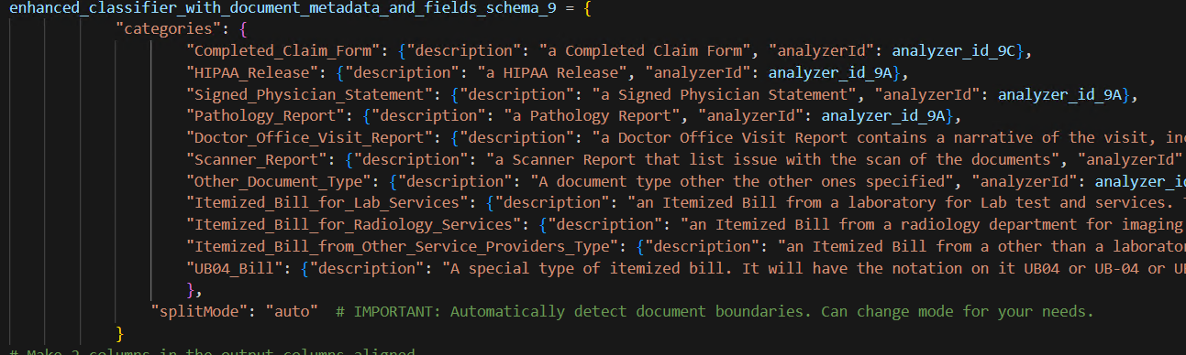
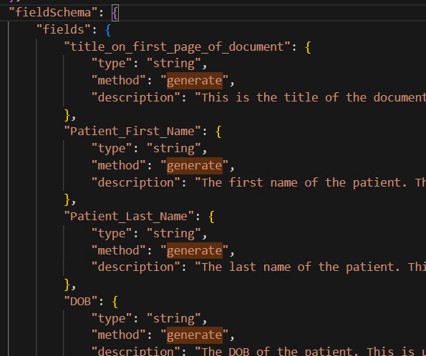
A use case example
Field Schema for non-bills, non-claim forms document types
Auditing of submitted medical charges for a claims processing company
Document Title
Analyzer 1
Field Schema for bills
Itemized charges
Classifier
Analyzer 2
Automatic unbundling of single file into constituent documents
Analyzer 3
Patient Information
Schema (11 document types)
Field Schema for claim forms
The blue text in the schema is the name of the analyzer to use for this type of document

Slide 8
Generate vs extract
Content Understanding's field extraction makes it easier to generate structured output from unstructured content.
Define a schema to extract, classify, or generate field values with no complex prompt engineering
Extract: Directly extract values as they appear in the input content, such as dates from receipts or item details from invoices.
Classify: Classify content from a predefined set of categories, such as call sentiment or chart type.
Generate: Generate values freely from input data, such as summarizing an audio conversation or creating scene descriptions from videos.
All extracted fields that are captured directly from the document use Document Intelligence like models.
Only classify and generated model use an LLM. LLMs are not used for OCR.

Slide 9
Service capabilities
Capabilities | Document Intelligence | Content Understanding | Build Your Own with AOAI
OCR | Industry leading OCR | Industry leading OCR | Requires preprocessing
Complex document structure | Layout with tables, sections, selection marks, figures, and more | Layout with tables, sections, selection marks, figures, and more | Requires preprocessing
Extract fields | Yes | Yes | Yes
Confidence and Grounding | Yes | Yes | No, requires extra implementation
Inferred fields | No | Yes, has support for generative and classify fields | Yes
Generate metadata | No | Yes | Yes
Post-processing | Limited | Custom with limitations | User defined process
Process large files | Yes | Yes | Requires chunking and other strategies to get optimal performance
Ease of use | Requires labeling and training to build a custom model, can directly use layout and prebuilt models | Simple schema definition without any labeling required to get zero shot results | Optimize results with prompt engineering
Scale for use | Managed | Managed | Manually scale components as needed
Latency | Low | Medium | Depends on PTUs deployed
Multi-file inputs | No | Yes, support in multi file analysis or Pro Mode | No
Knowledge base | No | Yes | Complex and requires engineering
Reasoning | No | Yes, support in multi file analysis or Pro Mode | Complex and requires engineering

Slide 10

How it works
If “method” = “extract”
Extracted Content
Content Understanding
Extracted
Fields
LLM
Generated Fields
If “method” = “generate”
Output
Contains
Extracted content
+
Extracted fields
+
Generated Fields
The OCR is done the same way regardless of whether a field’s method is marked “extract” or “generate”. For “generate” fields the OCR extract is then used as content and the description in the schema is used as a prompt to call a LLM to get a response providing the generated value for the field.
(This is like what you get from Document Intelligence)

Slide 11
OCR performance
Content Understanding provides the same quality of OCR as Document Intelligence.
It provides confidence scores just like Document Intelligence does.
It give you the capability to enhance the OCR with generated fields and classified fields.

Slide 12
How to handle pages with low confidence – a possible solution
Extracted Content
Content Understanding
Confidence Score
If “method” = “extract”
High Confidence
Yes or No
Extracted
Fields
No
Yes
If “method” = “generate”
LLM
Generated Fields
Output
Contains
Extracted content
+
Extracted fields
+
Generated Fields
+
LLM Extracted Fields
Extract Content
LLM Extracted
Fields
LLM
This part of the workflow is a “build-your-own”

Slide 13
Resources
What is Azure AI Content Understanding?
Choose the right tool for document processing
What's new
Create an Azure AI Foundry resource
Service quotas and limits
Language and region support
Pricing
FAQ
Glossary
Document Modality
Overview
Elements 🆕
Markdown 🆕
Enrichments

